Slide 1
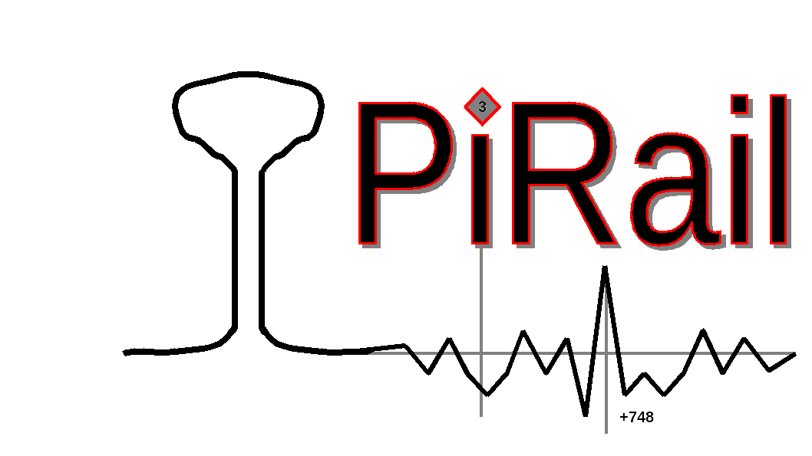

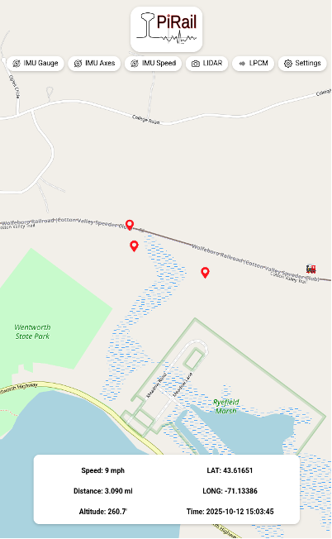
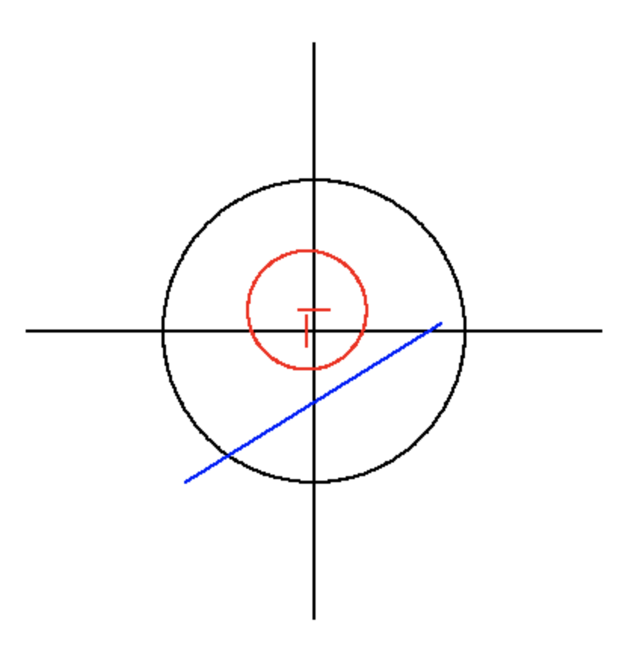
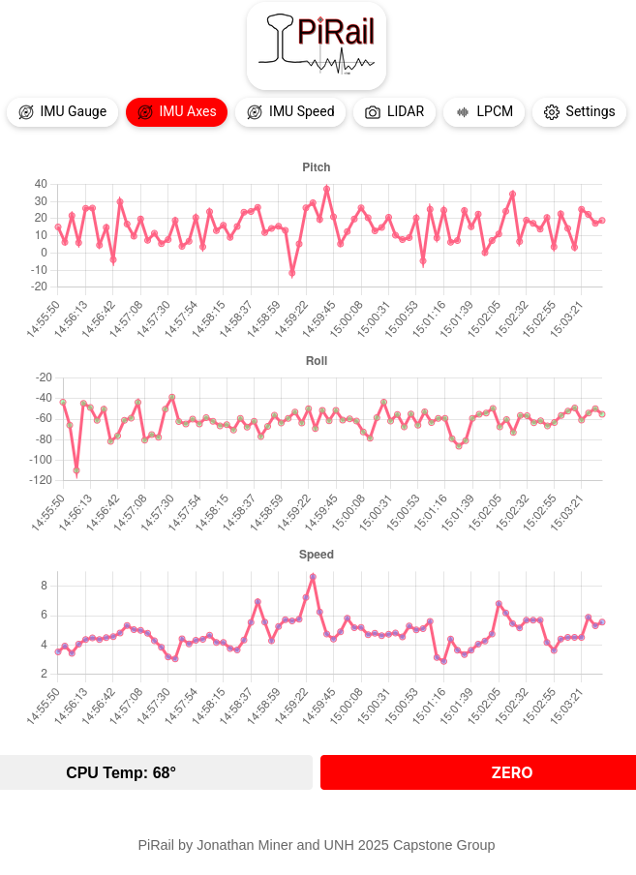
PiRail: Railway Fault Detection
Raven Hodgdon, Bohdan Barnett, Zachary Dubuc, Quinton Center, Joshua Beaton, Aidan McErlain
Department of Computer Science, University of New Hampshire
Introduction
Design
The original IMU display showed only the current data of pitch, roll, and yaw:
We were able to make a system that automatically detects anomalies on pre-determined set ranges when reading through a data-set
PiRail is a budget-friendly railway inspection system that uses GPS, IMU, and LIDAR sensors to identify and geolocate track defects in real time. Modern automated inspection technologies can be expensive. PiRail aims to provide an affordable alternative while promoting student research in this field. This year's project was to analyze data in real time and display on a live web app.
Our focuses for the PiRail project were on improving the user interface to make it easier to navigate, upgrading the launcher to streamline the development process, and implementing automatic POI detection that will appear on the map.
We planned to analyze the data to find the largest differences in acceleration between adjacent data points, and add new POIs based on the 25 greatest differences found.
The user interface was also a point that needed to be improved, as the IMU display was extremely limited in what it could do.
Evaluation & Conclusion
Requirements
This was problematic because it made it difficult to understand the larger patterns that were happening in the data and identify unusual activity at a glance.
The app is able to place POIs on the map based on our data sets gathered.
We have also made progress toward running the app on MacOS and running on Windows using Windows Subsystem for Linux, making testing and debugging easier and more convenient.
Conclusions:
Identifying potential damage to railroad tracks early is extremely important so that repairs can be made before an accident occurs.
Collecting accurate and precise data is crucial for reliably identifying potential points of interest.
Additional machine learning methods may assist with POI detection.
Functional
Live IMU Strip Charts
Many points of interest can be visually identified from data plots. This plot should mirror what is felt on board the rail car.
Point of Interest Display
Using the map, it should be possible and easy to return to a logged point of interest.
Point of Interest Detection
A POI should automatically be flagged when it is encountered by the sensors.
Implementation & Testing
We added a display that can show the IMU data as it changes over time as well as updating the overall GUI:
Data was collected on the Cotton Valley Rail Trail in Wolfeboro, NH. An experiment was conducted in which a rail cart equipped with the PiRail box was pushed over a variety of artificial bumps placed on an otherwise well- maintained rail segment. Two recordings were also done on prolonged railcar trips.
Data analysis was performed outside of the app on the datasets from Wolfeboro.
The data can then be fed into the app for viewing, and POIs can be displayed based on the analysis.
Our sponsor runs a test bed that simulates the behavior of the PiRail device by feeding the app with data recorded from these previous real-world tests. We can access the test bed remotely for the purposes of testing.
Non-Functional
Thorough Documentation
Those working on the project after us should be able to easily pick up where we left off
Easily Usable GUI
Any railroad operator/maintainer should be able to go onto our app and easily read the data/know when something is wrong
Next Steps
Test the POI detection to see whether it can accurately detect damage to rails.
Sponsor
Jon Miner

